Slide 1
LIGHTWEIGHT DEEP LEARNING IDS FOR RESOURCE-CONSTRAINED IOT DEVICES
5/13/2026
Vivian Parmar
Supervisor
Dr. Russel Mesbah
Dr. Soheil Varastehpour
Vivian Sureshbhai Parmar Student ID: 1604513
Notes:
Good morning everyone. My name is Vivian Sureshbhai Parmar, and today I will present my thesis proposal titled “Lightweight Deep Learning IDS for Resource-Constrained IoT Devices.” This research focuses on developing an efficient deep learning-based intrusion detection system suitable for low-resource IoT environments such as Raspberry Pi devices.

Slide 2
INTRODUCTION
5/13/2026
Lightweight Deep Learning IDS for IoT
Addressing security needs in resource-constrained IoT devices
Key Insights & Trends
Emergence of deep learning for intrusion detection
Balancing accuracy and eﬃciency in real-world IoT environments
Practical Solutions
Optimizing models with feature selection, pruning, and quantization
Deployable IDS for real-time security on low-powered devices
02.
Notes:
IoT devices are increasingly used in smart homes, healthcare systems, industrial environments, and smart cities. However, many IoT devices have limited processing power, memory, and energy resources, making cybersecurity implementation challenging. Traditional intrusion detection systems are often computationally expensive and unsuitable for such environments. Therefore, this research focuses on developing lightweight deep learning-based intrusion detection systems for efficient real-time IoT security. The research also explores optimization techniques such as feature selection, pruning, and quantization to improve deployment feasibility on low-powered devices.

Slide 3
5/13/2026
AGENDA
IoT Security
Challenges
Need for Lightweight IDS
Deep Learning IDS Overview
Research Gap & Objectives
Proposed Methodology & Architecture
Model Optimization & Evaluation
Expected Outcomes & Timeline
Dataset Selection
03.
Notes:
This presentation will discuss IoT security challenges, the need for lightweight intrusion detection systems, deep learning IDS concepts, the research gap and objectives, dataset selection, the proposed methodology and architecture, optimization techniques, evaluation metrics, expected outcomes, and the research timeline.

Slide 4
IOT SECURITY CHALLENGES
5/13/2026
Expanding IoT Ecosystem
IoT devices are integrated into smart homes, healthcare, industry, and cities.
Resource Constraints
Limited processing power, memory, and energy make security implementation challenging.
Common Attack Types
IoT networks face threats like DDoS, botnets, malware injection, and unauthorized access.
Impact of Vulnerabilities
Security gaps can lead to data breaches, service interruptions, and compromised network stability.
04.
Notes:
IoT ecosystems are rapidly expanding across many sectors including healthcare, industry, transportation, and smart homes. However, IoT devices are resource-constrained and often lack strong built-in security mechanisms. These networks face threats such as DDoS attacks, botnets, malware injection, and unauthorized access. Such vulnerabilities can lead to data breaches, service disruption, and compromised network stability.

Slide 5
NEED FOR LIGHTWEIGHT IDS
5/13/2026
Traditional IDS Limitations
High computational and memory requirements make them unsuitable for IoT devices.
Demand for Lightweight Solutions
IoT devices require IDS models with minimal resource consumption for real-time operation.
Balancing Eﬃciency and Accuracy
Optimizing IDS for speed and memory must not compromise detection performance.
Enabling Real-Time Security
Lightweight IDS models allow rapid threat detection directly on low-powered devices.
05.
Notes:
Traditional intrusion detection systems often require significant computational power, memory, and energy resources. This makes them unsuitable for low-powered IoT devices. Therefore, lightweight IDS solutions are required to provide efficient real-time security while maintaining strong detection performance. The major challenge is balancing computational efficiency with detection accuracy.

Slide 6
DEEP LEARNING IDS OVERVIEW
5/13/2026
Advanced Feature Extraction
Deep learning models like CNN and LSTM automatically learn complex patterns from network traﬃc.
Superior Attack Detection
Outperform traditional machine learning in identifying both known and unknown cyber threats.
Resource Intensive Models
Require significant computational power, memory, and energy, limiting deployment on IoT devices.
06.
Notes:
Deep learning models such as CNN and LSTM have shown strong performance in intrusion detection because they can automatically learn complex network traffic patterns. These models can detect both known and unknown attacks more effectively than traditional machine learning approaches. However, deep learning models are often computationally expensive, limiting their deployment on resource-constrained IoT devices. Therefore, optimization becomes important for practical deployment.

Slide 7
RESEARCH GAP
5/13/2026
Current IDS Models Prioritize Accuracy
Most deep learning IDS research focuses on maximizing detection rates, oflen overlooking
eﬃciency and scalability.
Limited Real-World IoT Testing
Few models are evaluated on actual resource-constrained IoT hardware like Raspberry Pi, raising concerns about practical deployment.
Balancing Performance and Resources
Urgent need for IDS solutions that maintain high detection accuracy while minimizing computational and memory demands.
Trade-Offs Remain Unaddressed
Existing approaches rarely optimize for both real-time eﬃciency and robust security in IoT environments.
07.
Notes:
Most existing deep learning IDS studies focus mainly on maximizing detection accuracy while overlooking computational efficiency and deployment feasibility. In addition, very few studies evaluate models on resource-constrained IoT hardware such as Raspberry Pi. Current research also struggles to properly balance efficiency, memory usage, inference time, and detection performance. Therefore, there is a need for lightweight IDS models suitable for practical IoT deployment.

Slide 8
RESEARCH OBJECTIVES & QUESTIONS
5/13/2026
1
Developing Deep Learning Lightweight Model Creation IDS
Balancing Accuracy & Eﬃciency
2
3
Design an intrusion detection
system using deep learning tailored for IoT networks.
Focus on building models optimized for
resource-constrained devices like Raspberry Pi.
Aim for high detection accuracy
with minimal computational overhead.
4
Performance Benchmarking
5
Key Research Questions
Evaluate and compare the
proposed model against traditional deep learning IDS solutions.
How to minimize model complexity while maintaining detection
performance?
What optimization techniques best balance efficiency and accuracy?
08.
Notes:
The primary objective of this research is to develop a lightweight deep learning-based intrusion detection system for IoT environments. The study focuses on reducing model complexity while maintaining strong detection performance. Key research questions include identifying optimization techniques that best balance efficiency and accuracy and evaluating the proposed model against conventional deep learning IDS solutions.

Slide 9

DATASET SELECTION
5/13/2026
Benchmark Datasets for IDS
Data Preparation
Enhances Performance
Addressing Class Imbalance
NSL-KDD: Structured, widely
adopted, eliminates redundant records
UNSW-NB15: Captures modern,
realistic attack types and current network behaviors
Feature selection and preprocessing streamline model efficiency and
reduce computational cost
Data exploration and balancing techniques improve detection accuracy
9.
Notes:
This research uses two benchmark datasets: NSL-KDD and UNSW-NB15. NSL-KDD is widely used in IDS research and removes redundant records from earlier datasets. UNSW-NB15 contains more modern and realistic attack scenarios and network traffic behaviors. Data preprocessing and feature selection techniques will also be applied to improve model efficiency and reduce computational overhead.

Slide 10



PROPOSED METHODOLOGY
5/13/2026
Structured Four-Step
Approach
Data preparation, model engineering, lightweight
optimization, and evaluation form the core workflow.
Reducing Model Complexity
Emphasis on minimizing model size and memory consumption for IoT
deployment.
Feature selection and pruning eliminate unnecessary
computations.
Lightweight Optimization Techniques
Model simplification, pruning, and quantization ensure
efficient operation on
resource-constrained devices.
Performance
Benchmarking
Comparison with
conventional deep learning IDS models highlights
improvements in scalability and efficiency.
Notes:
The proposed methodology follows four main stages: data preparation, model development, lightweight optimization, and evaluation. The research focuses on reducing model complexity and memory usage while maintaining strong detection performance. Optimization techniques such as pruning, quantization, and model simplification will be used to improve deployment feasibility on IoT devices. The proposed system will also be compared against conventional deep learning IDS models.

Slide 11
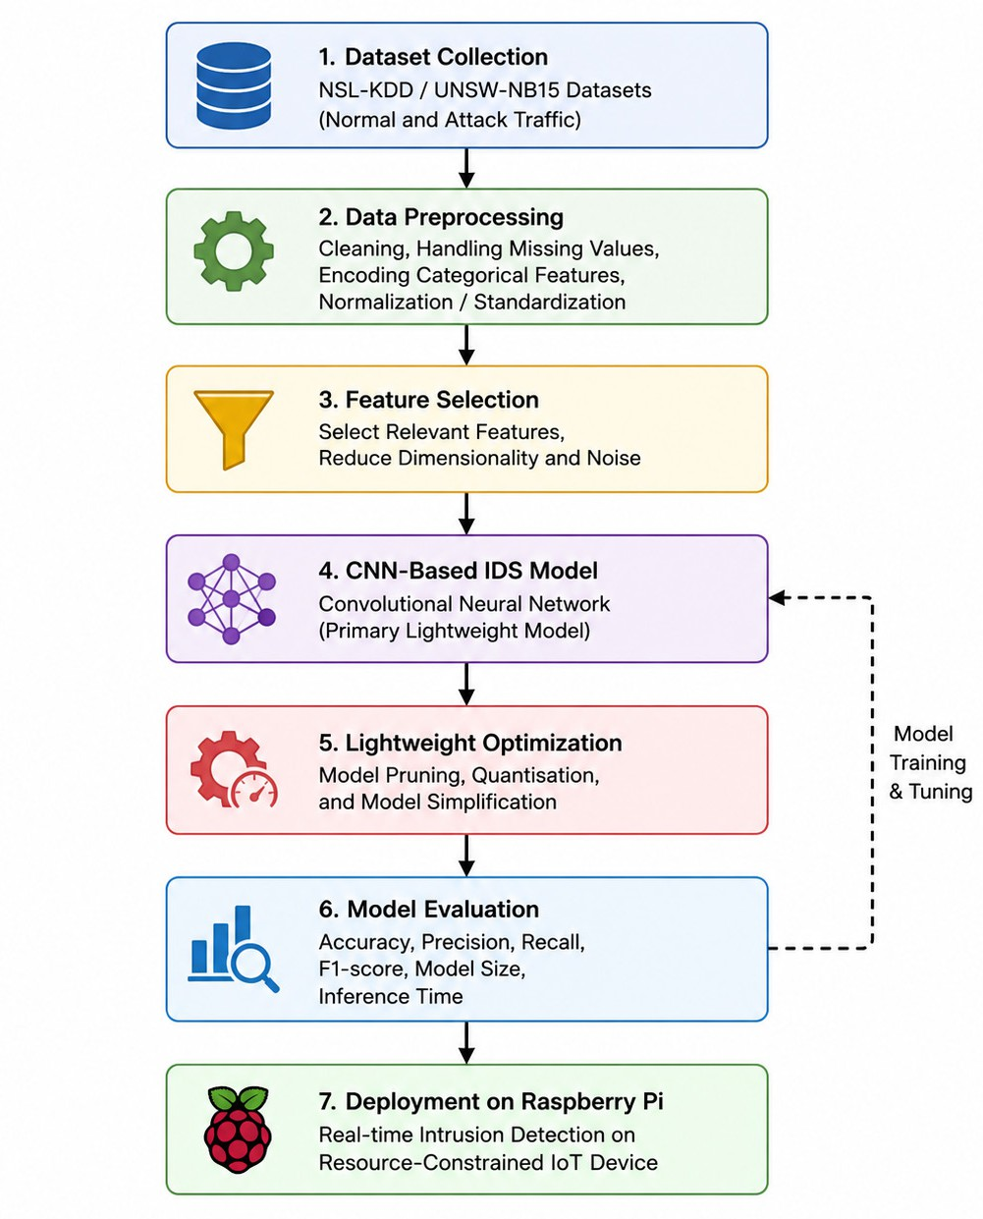
PROPOSED ARCHITECTURE DIAGRAM
5/13/2026
Notes:
The proposed architecture begins with dataset collection and preprocessing. Feature selection is then applied to reduce computational overhead and dimensionality. A lightweight CNN-based IDS model is used for intrusion detection because of its efficient feature extraction capability. Optimization techniques such as pruning and quantization are applied to reduce model size and inference time. Finally, the model is evaluated using both detection and efficiency metrics before deployment on Raspberry Pi devices.

Slide 12
CNN MODEL & OPTIMIZATION
5/13/2026
Eﬃcient Feature
Extraction with CNN
Model
Simpliﬁcation Strategies
Pruning and Quantization Techniques
Hybrid
CNN-LSTM
Models
Reduced layers and
parameters to minimize computational overhead
Optimized for deployment on devices like Raspberry Pi
Pruning removes
redundant connections, lowering memory usage
Quantization reduces
weight precision, speeding up inference and saving
energy
Hybrid models considered for combining spatial and temporal analysis
Performance compared to pure CNN for optimal
Balance
This will be used after CNN models success
CNN architecture excels at capturing spatial patterns in network traffic data
Chosen for its energy
efficiency and suitability for resource-limited IoT devices
Notes:
CNN is selected as the primary model because it provides efficient feature extraction with lower computational overhead compared to recurrent models such as LSTM. Optimization techniques such as pruning, quantization, and model simplification are used to reduce memory usage and computational complexity. Hybrid CNN-LSTM models may also be explored for comparative analysis. The overall goal is to achieve strong detection performance while supporting lightweight IoT deployment.

Slide 13

EVALUATION METRICS
5/13/2026
Detection Performance Metrics
Evaluate using accuracy, precision, recall, and F1-score to measure attack detection effectiveness.
Confusion matrix analysis for true/false positives and negatives.
Efficiency and Resource Metrics
Assess model size, training time, and
inference time for deployment feasibility on IoT devices.
Monitor memory usage and
computational overhead during real-time operation.
Benchmarking and Comparison
Compare lightweight IDS with
conventional deep learning models using NSL-KDD and UNSW-NB15 datasets.
Highlight improvements in scalability and efficiency for resource-constrained
environments.
Notes:
The proposed model will be evaluated using both detection and efficiency metrics. Detection performance will be measured using accuracy, precision, recall, and F1-score. Efficiency metrics such as inference time, memory usage, and model size will also be analyzed to determine deployment feasibility on IoT devices. The proposed lightweight IDS will then be compared against conventional deep learning IDS models.

Slide 14



EXPECTED OUTCOMES
5/13/2026
Eﬃcient
Intrusion Detection
High
Detection
Performance
Real-Time IoT Deployment
Balanced Eﬃciency
and Accuracy
Enables real-time
detection on devices like Raspberry Pi
Lightweight IDS achieves reduced
computational and memory complexity
F1-scores consistently above 85% with
optimized models
Model size reduced by 30-50% compared to conventional IDS
Provides valuable
insights into efficiency vs. accuracy trade-offs for IoT security
Notes:
The expected outcome is a lightweight deep learning-based IDS capable of achieving strong intrusion detection performance while significantly reducing computational complexity and model size. The research aims to achieve F1-scores above 85% and approximately 30 to 50 percent reduction in model size compared to conventional IDS models. The proposed system is also expected to support real-time deployment on Raspberry Pi devices.

Slide 15
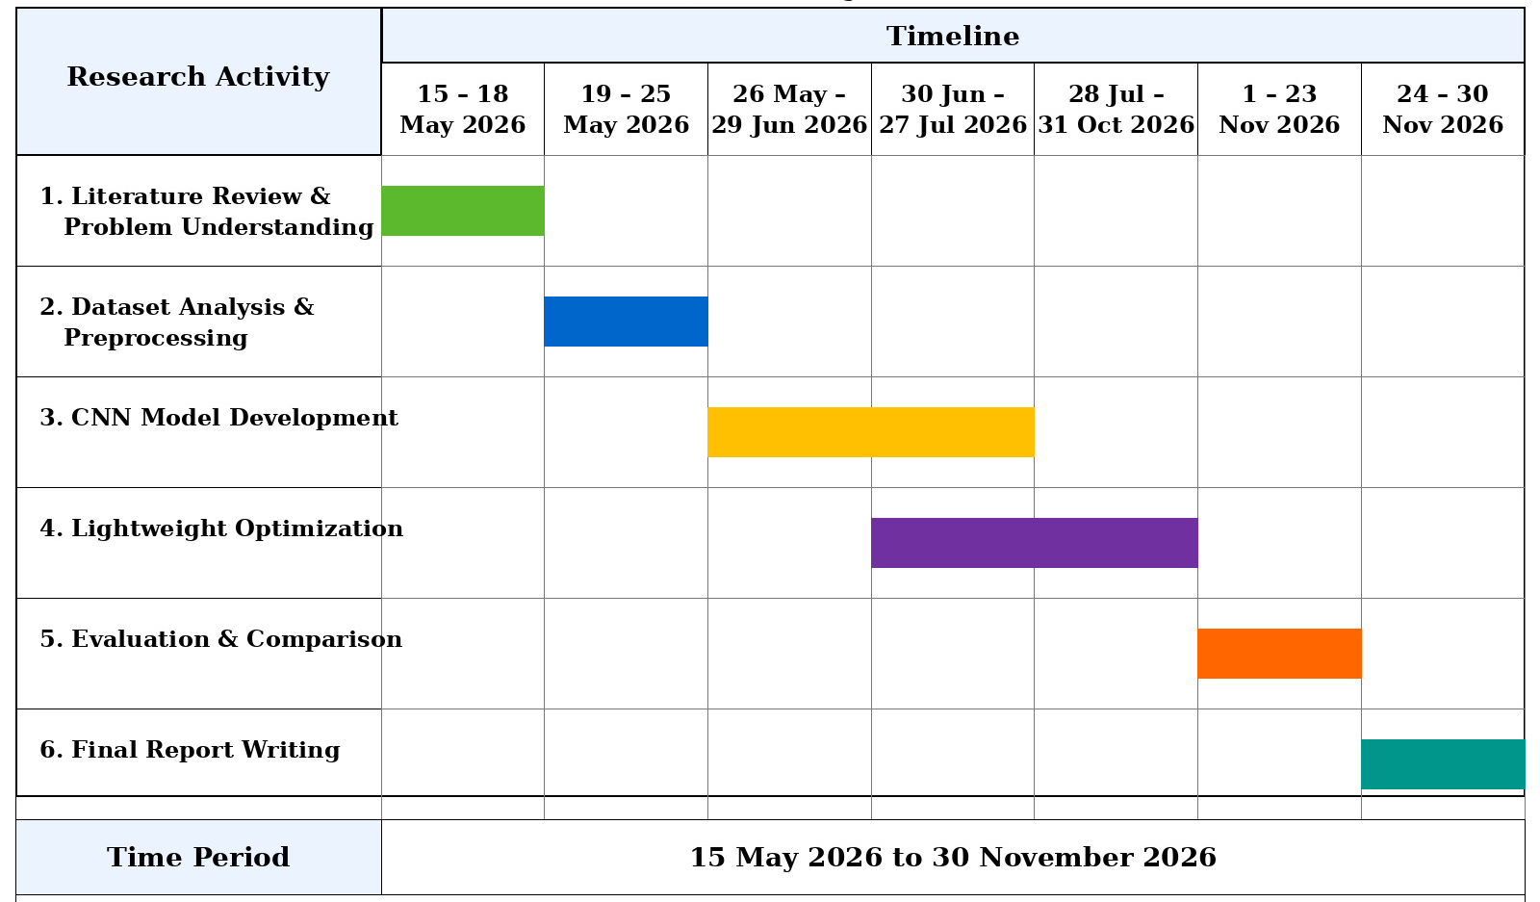
TIMELINE
5/13/2026
Notes:
The research timeline spans from May 2026 to November 2026. The project includes literature review, dataset preprocessing, CNN model development, lightweight optimization, evaluation, and final thesis writing. The timeline ensures systematic progress across all research phases.

Slide 16

CONCLUSION
5/13/2026
Enhancing IoT Security
Lightweight deep learning IDS models provide robust protection for IoT
networks.
Effective detection of diverse cyber threats in real-time environments.
Feasible Deployment on IoT Devices
Optimization techniques like pruning and quantization enable IDS to run on
resource-constrained devices.
Reduced model size and inference time support practical implementation.
Balancing Eﬃciency and Accuracy
Careful model design ensures high detection rates with minimal
computational overhead.
Trade-offs between speed and accuracy are addressed for real-world IoT
applications.
Notes:
In conclusion, this research proposes a lightweight deep learning-based intrusion detection system for resource-constrained IoT devices. The study focuses on balancing computational efficiency and detection performance while enabling real-time IoT deployment. Optimization techniques such as pruning and quantization are expected to improve deployment feasibility on low-resource devices. Overall, the research aims to contribute toward scalable and practical IoT cybersecurity solutions.

Slide 17
References
5/13/2026
M. Tavallaee, E. Bagheri, W. Lu, and A. A. Ghorbani, “A detailed analysis of the KDD CUP 99 data set,” in Proc. IEEE Symp. Computational Intelligence for Security and Defense Applications (CISDA), 2009, pp. 1–6.
N. Moustafa and J. Slay, “UNSW-NB15: A comprehensive data set for network intrusion detection systems (UNSW-NB15 network data set),” in Proc. Military Communications and Information Systems Conf. (MilCIS), 2015, pp. 1–6.
G. Kim, S. Lee, and S. Kim, “A novel hybrid intrusion detection method integrating anomaly detection with misuse detection,” Expert Systems with Applications, vol. 41, no. 4, pp. 1690–1700, 2014.
C. Yin, Y. Zhu, J. Fei, and X. He, “A deep learning approach for intrusion detection using recurrent neural networks,” IEEE Access, vol. 5, pp. 21954–21961, 2017.
M. S. Hossain, M. Al-Rakhami, and G. Muhammad, “Lightweight intrusion detection system for IoT using deep learning,” IEEE Access, vol. 8, pp. 123–134, 2020.
K. Alrawashdeh and C. Purdy, “Toward an online anomaly intrusion detection system based on deep learning,” in Proc. IEEE Int. Conf. Machine Learning and Applications (ICMLA), 2016.
A. Javaid, Q. Niyaz, W. Sun, and M. Alam, “A deep learning approach for network intrusion detection system,” in Proc. EAI Int. Conf. Bio-inspired Information and Communications Technologies, 2016.
Y. Meidan et al., “N-BaIoT: Network-based detection of IoT botnet attacks using deep autoencoders,” IEEE Pervasive Computing, vol. 17, no. 3, pp. 12–22, 2018.
H. Hindy et al., “A taxonomy of network threats and intrusion detection systems,” IEEE Access, vol. 8, pp. 119–151, 2020.
R. Doshi, N. Apthorpe, and N. Feamster, “Machine learning DDoS detection for consumer Internet of Things devices,” in Proc. IEEE Security and Privacy Workshops (SPW), 2018, pp. 29–35.

Slide 18
References
5/13/2026
M. Ring, D. Schlör, D. Landes, and A. Hotho, “A survey of network-based intrusion detection data sets,” Computers & Security, vol. 86, pp. 147–167, 2019.
W. Wang et al., “HAST-IDS: Learning hierarchical spatial-temporal features using deep neural networks,” IEEE Access, vol. 6, pp. 1792–1806, 2017.
S. Shone, T. N. Ngoc, V. D. Phai, and Q. Shi, “A deep learning approach to network intrusion detection,” IEEE Trans. Emerging Topics in Computational Intelligence, vol. 2, no. 1, pp. 41–50, 2018.
A. A. Diro and N. Chilamkurti, “Distributed attack detection scheme using deep learning approach for Internet of Things,” Future Generation Computer Systems, vol. 82, pp. 761–768, 2018.
S. U. Jan, S. Ahmed, V. Shakhov, and I. Koo, “Toward a lightweight intrusion detection system for the Internet of Things,” IEEE Access, vol. 7, pp. 42450–42471, 2019.
Z. Wang, H. Chen, S. Yang, X. Luo, D. Li, and J. Wang, “A lightweight intrusion detection method for IoT based on deep learning and dynamic quantization,” PeerJ Computer Science, vol. 9, p. e1569, 2023.
C. Wei, G. Xie, and Z. Diao, “A lightweight deep learning framework for botnet detecting at the IoT edge,” Computers & Security, vol. 129, p. 103195, 2023.
M. Berhili, O. Chaieb, and M. Benabdellah, “Intrusion detection systems in IoT based on machine learning: A state of the art,” Procedia Computer Science, vol. 251, pp. 99–107, 2024.
M. H. Bhuyan, D. K. Bhattacharyya, and J. K. Kalita, “Network anomaly detection: Methods, systems and tools,” IEEE Communications Surveys & Tutorials, vol. 16, no. 1, pp. 303–336, 2013.
I. Butun, P. Österberg, and H. Song, “Security of the Internet of Things: Vulnerabilities, attacks, and countermeasures,” IEEE Communications Surveys & Tutorials, vol. 22, no. 1, pp. 616–644, 2019.

Slide 19
Thank you
5/13/2026

